Slide 1
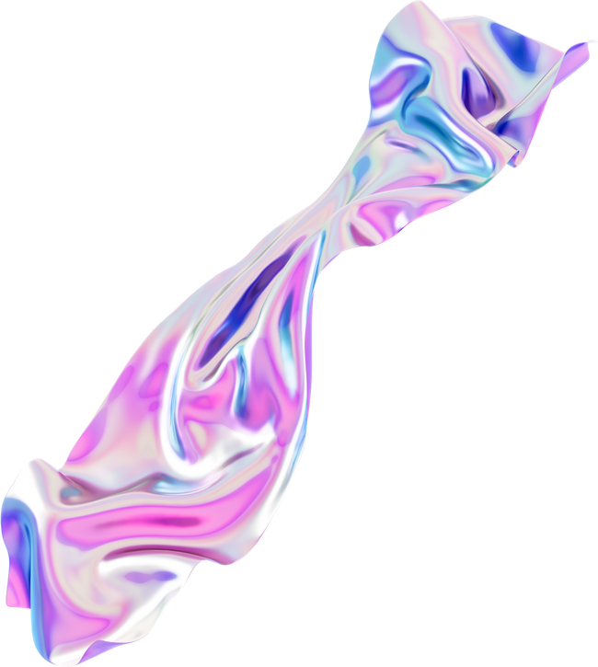
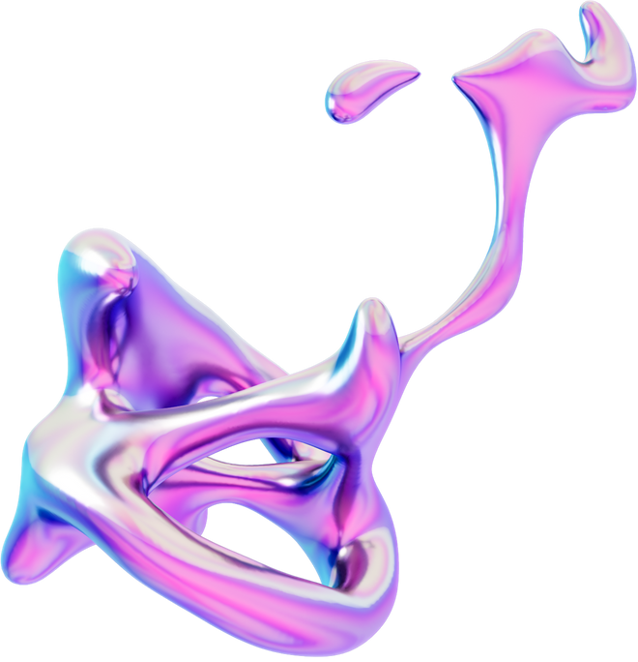

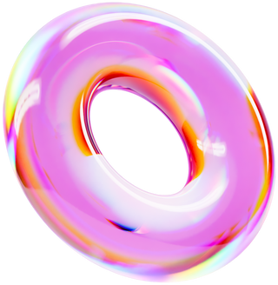
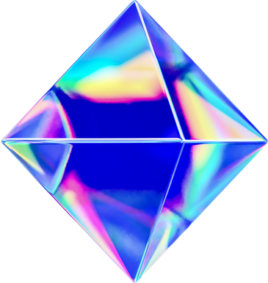
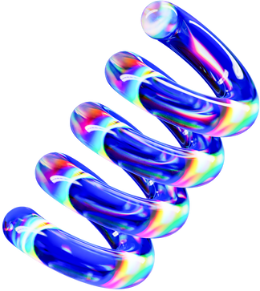
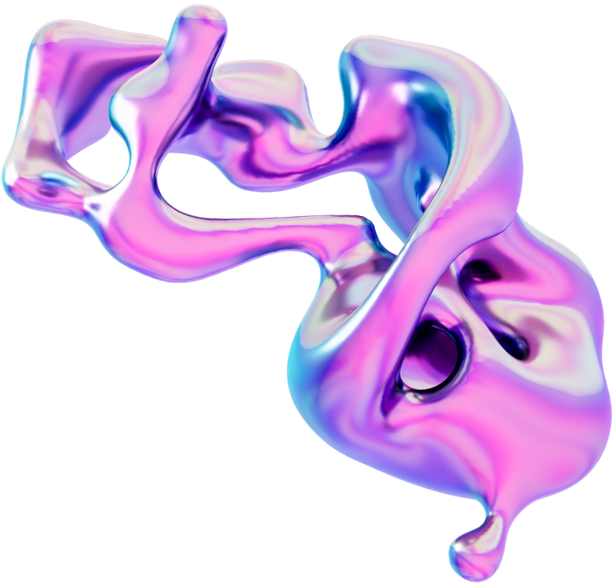

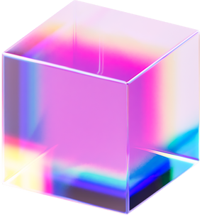
AI-POWERED SMART PILLS: ADAPTIVE DRUG DELIVERY FOR PERSONALIZED MEDICINE
ALVIYA JINOY , ESTHER AJITH GEORGE , VARSHA J

Slide 2
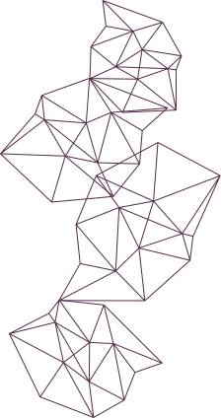
PROBLEM STATEMENT
Alzheimer’s patients often face medication adherence challenges due to memory loss and cognitive decline. This results in missed doses, incorrect medication intake, and inconsistent symptom management, leading to faster disease progression, increased healthcare costs, and a higher caregiver burden. Current drug delivery methods rely on patient compliance, which is unreliable for individuals with Alzheimer’s.

Slide 3
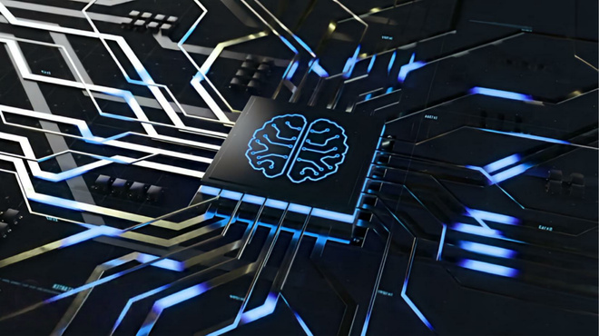
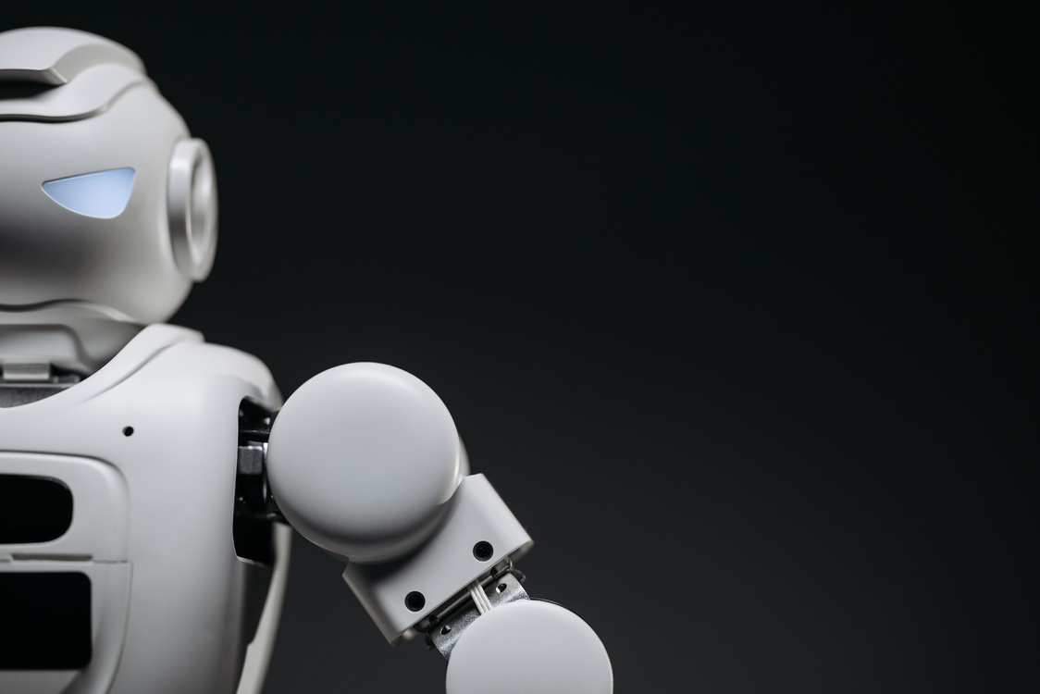

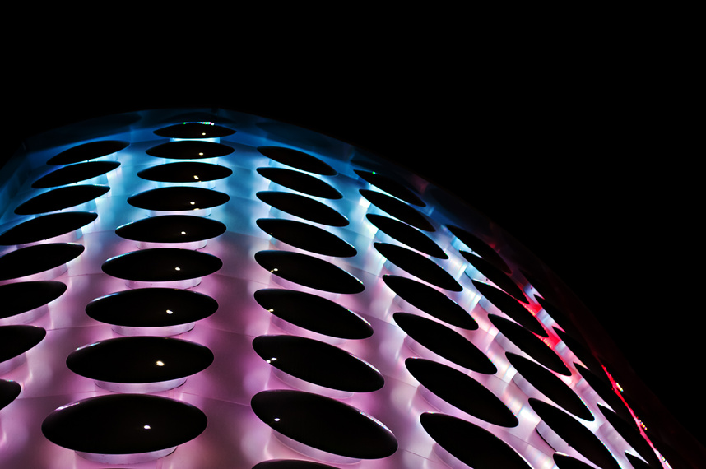
PROBLEM SOLUTION
Real-Time Monitoring
AI-Driven Analysis:
Adaptive Drug Release:
Remote Connectivity
Uses advanced AI algorithms and machine learning models to analyze patient-specific health data.
Predicts optimal drug dosage, timing, and absorption rates based on real-time and historical data.
Identifies patterns in drug response, adjusting treatment for maximum efficacy and minimal side effects.
Modifies drug release in real-time based on body conditions to avoid over- or under-dosing.
Ensures precise medication absorption, improving treatment efficiency for chronic diseases (e.g., diabetes, cardiovascular conditions).
Enhances bioavailability by delivering the drug at the most effective site inside the body.
Uses secure wireless transmission (Bluetooth, IoT, 5G, or NFC) to send real-time health reports to doctors.
Allows remote patient monitoring, reducing hospital visits and improving healthcare efficiency.
Alerts patients and caregivers in case of missed doses, critical health changes, or abnormal responses.
Equipped with biocompatible nano-sensors to track vital signs.
Continuously measures temperature, glucose levels, pH, heart rate, hydration levels, and digestion rates.
Detects anomalies in metabolism to prevent adverse reactions or ineffective drug absorption.

Slide 4
SOLUTION STATEMENT
AI-powered Smart Pills offer an innovative solution by:
✅ Personalizing Drug Release: Automatically adjusting dosage based on real-time physiological data.
✅ Tracking Cognitive Biomarkers: Monitoring brain activity, heart rate, and other vitals to optimize treatment.
✅ Automating Medication Administration: Reducing reliance on memory and ensuring consistent drug intake.
✅ Providing Remote Monitoring: Sending health updates to doctors and caregivers, enabling timely intervention.
This adaptive system improves medication adherence, enhances patient outcomes, and reduces caregiver stress.

Slide 5
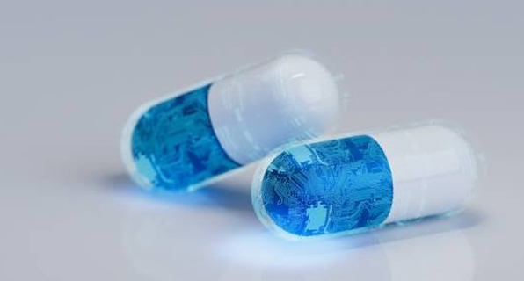
WHAT IS SMART PILLS ?
Smart pills can be defined as an ingestible capsule containing electronic or mechanical elements that traverse the gastrointestinal (GI) tract for purposes ranging from diagnosis, treatment, sampling or surgery. These pills are easily swallowed by most people, thereby resulting in minimal discomfort, greater patient acceptance and can traverse the entire length of the GI tract.
From a therapeutic perspective, these devices open up the possibility of localised, targeted delivery of therapeutic agents to specific regions of the GI tract or systemic delivery of biologics through transepithelial delivery.
Though smart pills capable of gastric pH monitoring were first reported as far back as 1965 and simple devices and smart pills for drug absorption studies along the GI tract were reported in 1961 and 1982, respectively , it is arguably the introduction of the capsule endoscope in 2000 ,that has lead to the increase in the number of smart pills reported in recent years.

Slide 6
HOW THE SMART PILL LOOKS LIKE ?
SIZE
SHAPE
Approximately 10-15mm in length and 5-7mm in diameter (similar to a regular capsule).
Material:
Capsule-shaped, smooth, and swallowable for easy ingestion.
Outer Appearance:
Biodegradable polymer or gelatin shell that dissolves at the right location in the body.
Can be fully opaque or semi-transparent to allow visualization of inner components.
Medical-grade colors (white, blue, or clear) for easy identification.

Slide 7
01
AI Processing chip
02
BIiosensors
AI Processing Chip – Runs machine learning algorithms to analyze real-time health data and adjust drug dosage accordingly.
Detects brain activity (EEG), heart rate, body temperature, pH levels, and movement to monitor the patient’s condition.
Key Components Inside the Smart Pill
03
Microfluidic Drug Reservoir
04
Controlled Drug Release System
Uses micro-pumps or dissolvable membranes to gradually release medicine at the right time and dosage.
Stores Alzheimer’s medication and ensures controlled, precise drug release as needed.
05
Wireless Communication Module
06
Miniature Battery or Energy-Harvesting System
Sends health updates to doctors and caregivers via Bluetooth, 5G, or IoT for remote monitoring.
`
Powers the AI system and sensors using biodegradable microbatteries, body fluids, or heat energy.

Slide 8
HOW IT WORKS ?
✅ Step 1: Initialization & Setup
Power ON sensors, AI processor, and drug reservoir.
Run self-diagnostics and connect to patient’s smartphone or healthcare system.
Retrieve patient medical history for personalized treatment.
✅ Step 3: AI-Based Data Analysis
AI analyzes sensor data and compares it with baseline patterns.
Decision:
Stable: No drug release.
Symptoms worsen: AI calculates and adjusts drug dosage.
✅ Step 5: Wireless Communication & Alerts
Logs drug history and sends alerts to doctors/caregivers for:
Worsening symptoms, unusual behavior, or health emergencie
✅ Step 6: End of Drug Lifecycle & Pill Exit
Pill dissolves (if biodegradable) or exits naturally.
AI powers down after monitoring.
✅ Step 2: Real-Time Patient Monitoring
Activate biosensors to monitor brain activity, heart rate, temperature, and motion.
Continuously send data to the AI processor.
✅ Step 4: Smart Drug Release Mechanism
AI signals drug reservoir to release precise dosage.
Adjusts timing for effectiveness and stops release if side effects are detected

Slide 9
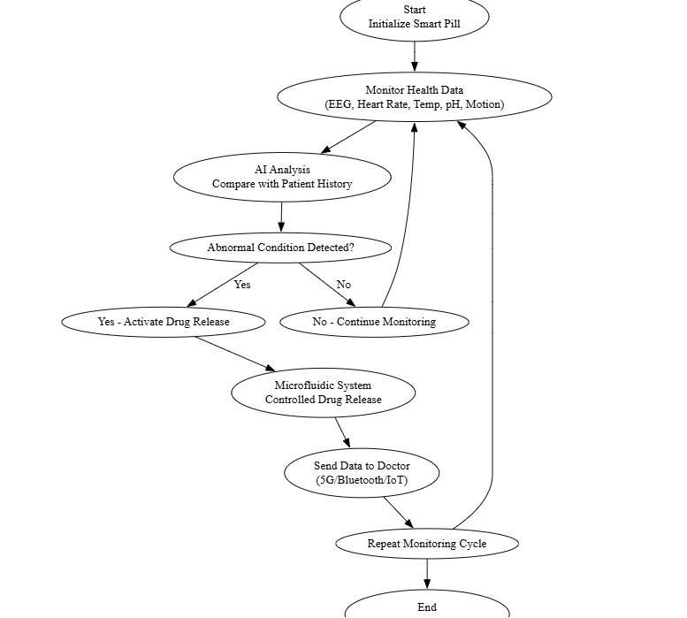
ALGORITHM

Slide 10
IMPACT OF AI-POWERED SMART PILLS
Enhanced Drug Efficacy
Reduced Side Effects & Toxicity
Improved Patient Compliance & Convenience
Lower Healthcare Costs
Enhanced Drug Efficacy – AI-driven adaptive release ensures precise drug absorption, improving treatment effectiveness.
Targeted drug delivery minimizes exposure to healthy tissues, lowering adverse effects.
Fewer hospital visits and complications decrease overall medical expenses.
Automated dosing schedules reduce patient effort and enhance adherence.
Revolutionizing Chronic Disease Management
Advancements in Personalized Medicine
Smart pills enable real-time monitoring and personalized treatment adjustments.
AI-driven analysis tailors drug therapy to individual patient needs for better outcomes.

Slide 11
Technical Feasibility
Medical Feasibility
Miniaturized Biosensors: Tiny sensors for EEG, heart rate, pH, temperature, and motion detection are already used in medical wearables.
✔ Microfluidic Drug Release Systems: Controlled drug release using micro-pumps or dissolvable membranes has been tested in smart capsules (e.g., MIT’s RoboCap).
✔ AI & Machine Learning: AI algorithms for predictive drug release and patient monitoring exist in wearables and remote healthcare devices.
✔ Wireless Communication: Bluetooth, 5G, and IoT-based medical devices are widely available for real-time doctor-patient connectivity.
Accurate Drug Delivery: Ensures timely, personalized dosage, reducing over-medication risks.
✔ Non-Invasive Monitoring: Unlike brain implants, this provides real-time cognitive and physiological tracking without surgery.
✔ Remote Doctor Supervision: Reduces hospital visits by alerting doctors in case of abnormalities.
✔ Better Compliance: Eliminates the need for patients or caregivers to remember medication schedules.

Slide 12

WHAT’S STILL A CHALLENGE?
❌ AI Processing in a Small Form Factor: Embedding an AI microchip inside a pill while keeping it small and power-efficient is challenging.
❌ Biodegradable Power Source: The pill needs a micro-battery or energy-harvesting technology (e.g., stomach acid-powered batteries), which is still in early research.
❌ Long-Term Stability of Electronics in the Body: Ensuring electronics survive stomach acid and intestinal fluids without causing harm.
Medical Challenges:
❌ Long-Term Effects Unknown: The body’s response to biodegradable smart pills with embedded electronics needs extensive human trials.
❌ Data Privacy & Security Risks: Health data transmission from a pill needs strong cybersecurity to prevent hacking or misuse.
❌ Regulatory Approval Delays: FDA and medical agencies require years of clinical trials before approving ingestible AI-powered pills.

Slide 13
APPLICATIONS
Neurological Disorders – Smart pills can monitor brain chemistry and release drugs for conditions like epilepsy, Parkinson’s, and depression.
Cardiovascular Diseases – AI-powered capsules can track blood pressure and heart rate, adjusting drug release for better cardiac management.
Obesity & Metabolic Disorders – Ingestible sensors can detect gut hormones and regulate appetite-controlling drug release.
Post-Surgical Recovery – Smart pills can deliver painkillers or antibiotics based on inflammation markers, improving healing outcomes.
Gastrointestinal Health – Targeted drug delivery for Crohn’s disease, ulcers, and acid reflux by detecting gut pH and inflammation.
Hormonal Therapies – Controlled hormone release for conditions like thyroid disorders, menopause, or testosterone regulation.
Infectious Disease Monitoring – Smart pills can detect early infection markers and adjust antibiotic release to prevent resistance
Sleep Disorders – AI-driven release of melatonin or other sleep aids based on circadian rhythm monitoring.

Slide 14
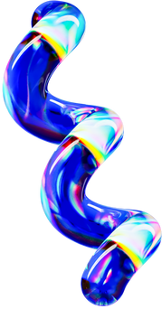


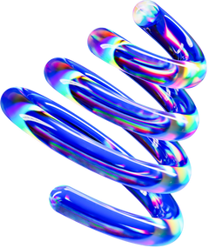
CONCLUSION
AI-powered Smart Pills offer a groundbreaking solution for managing Alzheimer’s by automating drug delivery, ensuring personalized dosage, and enhancing patient monitoring. By integrating biosensors, AI algorithms, and real-time data analysis, these pills improve medication adherence, reduce side effects, and ease caregiver burden. This innovative technology has the potential to slow disease progression, enhance patient outcomes, and revolutionize Alzheimer’s treatment through smarter and more adaptive healthcare solutions.

Slide 15
THANKYOU

